Slide 1
CSC410 - Professional Practices in IT
Instructor Name : Sidra Nasir

Slide 2
Today Topics
Social Implications of Computing & Networked Communications
Impact of Social Media on Individualism; and Collectivism & Culture
Moral issues associated with our use of the Internet and the telephone system
Spam
Internet Interactions
Text Messaging

Slide 3
Networked Communications
Networked communication has deeply integrated into modern life, enhancing interactions and tasks.
While it offers many benefits, it also brings challenges like spam, misuse, and censorship.
Understanding the ethical implications is key to managing its role in society.

Slide 4
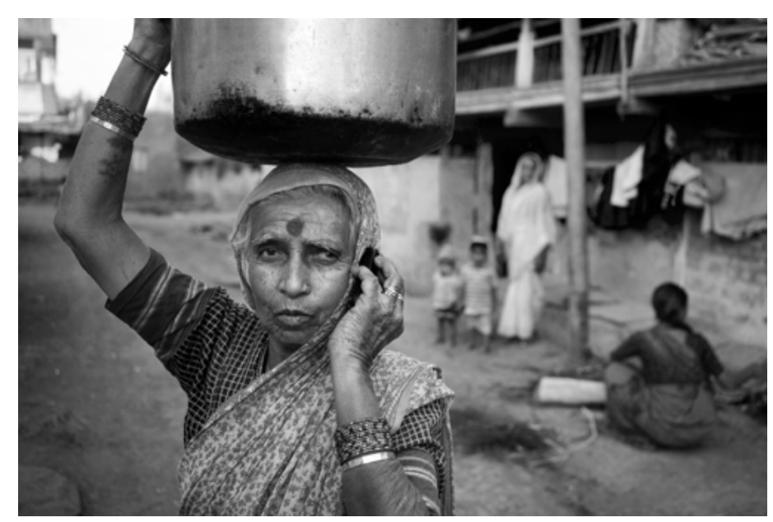
Far More People Have Access to Cell Phones than Electricity or Clean Water

Slide 5
Social Implications of Computing & Networked Communications

Slide 6
Social Implications of Computing & Networked Communications
Refer to the ways in which technologies like the internet, computers, and digital networks affect society.
These impacts are both positive and negative.

Slide 7
Improved Communication and Connectivity
Positive: Instant global communication and collaboration
Negative: Reduced face-to-face interactions and potential isolation

Slide 8
Access to Information and Education
Positive: Easier access to information and online learning
Negative: Spread of misinformation and false knowledge

Slide 9
Privacy and Security Concerns
Positive: Secure transactions and data management
Negative: Privacy issues, data breaches, and mass surveillance

Slide 10
Social Interactions and Relationships
Positive: Social media builds communities and connections
Negative: Social comparison, cyberbullying, and reduced personal interaction

Slide 11
Impact of Social Media on Individualism; and Collectivism & Culture.
Individualism: Social media empowers personal expression and self-promotion, allowing users to craft unique online identities but can sometimes lead to isolation.
Collectivism: It strengthens community bonds and collective movements, enabling group efforts, but can also create echo chambers that limit diverse perspectives.
Cultural Impact: Social media fosters cultural exchange and awareness globally, but can dilute local traditions and lead to cultural appropriation.

Slide 12
Moral issues associated with our use of the Internet and the telephone system

Slide 13
The Spam Epidemic (1/3)
Spam: Unsolicited, bulk email
Spam is profitable
– More than 100 times cheaper than “junk mail”
– Profitable even if only 1 in 100,000 buys product
Amount of email that is spam has ballooned – 8% in 2001 – 90% in 2009

Slide 14
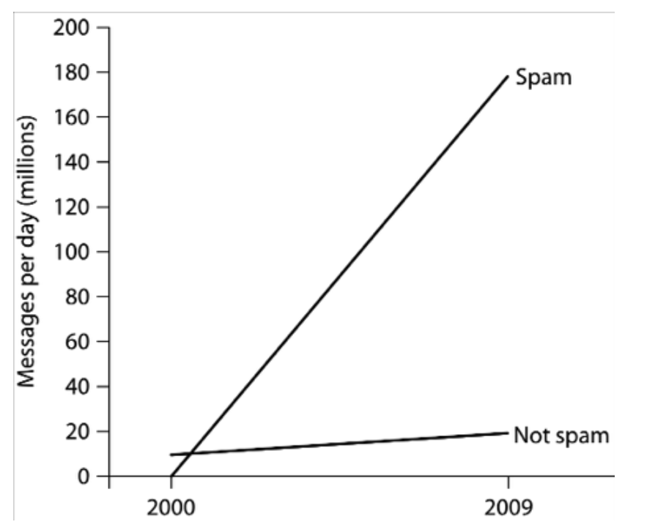
The Spam Epidemic (2/3)

Slide 15
The Spam Epidemic (3/3)
How firms get email addresses
– Web sites, chat-room conversations, newsgroups
– Computer viruses harvest addresses from PC address books
– Dictionary attacks
– Contests
Most spam sent out by bot herders who control huge networks of computers
Spam filters block most spam before it reaches users’ inboxes

Slide 16
Need for Social-Technical Solutions
New technologies sometimes cause new social situations to emerge
– Calculators → feminization of bookkeeping
– Telephones → blurred work/home boundaries
Spam an example of this phenomenon
– Email messages practically free
– Profits increase with number of messages sent
– Strong motivation to send more messages
Internet design allows unfair, one-way communications

Slide 17
Case Study: Ann the Acme Accountant
Ann is an accountant at Acme Corporation, a medium-sized firm with 50 employees. All of the employees work in the same building, and Ann knows all of them on a first name basis. In fact, Ann distributes paychecks to Acme’s employees at the end of every month. Ann’s 10-year-old daughter is a Girl Scout. During the annual Girl Scout cookie sale, Ann sent an email to all of the other Acme employees, inviting them to stop by her desk during a break and place orders. (There is no company rule prohibiting the use of the email system for personal emails.) Nine of the recipients were happy to get Ann’s email, and they ordered an average of four boxes of cookies, but the other 40 recipients did not appreciate having to take the time to read and delete an unwanted message; half of them complained to a coworker about Ann’s action. Did Ann do anything wrong?

Slide 18
Case Study: Ann the Acme Accountant
Ann: Accountant at Acme Corporation
She distributes paychecks to all 50 employees
Ann sends email advertising Girl Scout cookie sale
9 recipients order cookies; average 4 boxes each
Other 40 recipients unhappy to get email; half complain to a co-worker
Did Ann do anything wrong?

Slide 19
Kantian Analysis
We should always respect autonomy of others, treating them as ends in themselves and never only as the means to an end (2nd formulation of Categorical Imperative)
Ann didn’t misrepresent what she was doing
She didn’t force anyone to read the entire email
Some who read her email chose to order cookies
Therefore, she didn’t “use” others, and her action was not strictly wrong
However, an “opt in” approach would have been better

Slide 20
Act Utilitarian Analysis
Benefit to Girls Scouts = $108
– $3 profit per box of cookies
– 36 boxes sold
Harm to company: time wasted
– Orders taken during breaks
– Lost productivity from complaining: $70
20 employees ×2 ×5 minutes/employee = 200 minutes
3.5 hours ×$20/hour = $70
Benefits exceed harms, so action good
Company may create policy against future fundraisers

Slide 21
Rule Utilitarian Analysis
Q: What would be consequences of everyone in company used email to solicit donations?
A: Plenty of employee grumbling and lower morale
If all doing it, unlikely any one cause would do well
Harms greater than benefits, so Ann’s action was wrong

Slide 22
Social Contract Theory Analysis
Acme Corporation has no prohibition against using its email system this way
Ann was exercising her right to express herself
Some people didn’t appreciate message, but she didn’t act like a spammer
–She didn’t conceal her identity
– She wasn’t selling a fraudulent product
Ann did nothing wrong

Slide 23
Virtue Ethics Analysis
As employee, relevant virtues: honesty, fairness, respect
Ann was honest: her email didn’t mislead anyone
She wasn’t fair or respectful, and she exercised poor judgment (as evidenced by larger amount of complaining by co-workers)
In her role as parent, she did all work herself and didn’t find a role for her daughter to play
Ann should have found a way for her daughter to help, and she should have found another way to advertise that respected co-workers

Slide 24
Summary
Analyses reached different conclusions, but Ann could have taken a less controversial course
She could have posted a sign-up sheet to identify those interested in cookie sale
That way, she would have sent email only to those interested, avoiding the problems of grumbling and lost productivity
She could have found a way to get her daughter more engaged

Slide 25
Internet Interactions

Slide 26
The World Wide Web
WWW : networked hypertext system
Stimulated tremendous growth in popularity of Internet
Two important attributes
– It is decentralized
– Every Web object has a unique address

Slide 27
Rise of the App
People spending more time on smartphones and tablets
Using Web browsers awkward on mobile devices
Mobile apps replace Web browsers as way to access Internet on mobile devices

Slide 28
How We Use the Internet
Shopping
Socializing (e.g., Facebook)
Contributing content (e.g., wikis)
Blogging
Crowdsourcing
Learning
Exploring our roots

Slide 29
How We Use the Internet
Entering virtual worlds
Controlling the Internet of Things
Paying taxes
Gambling
Taking humanitarian action
Lots more!

Slide 30
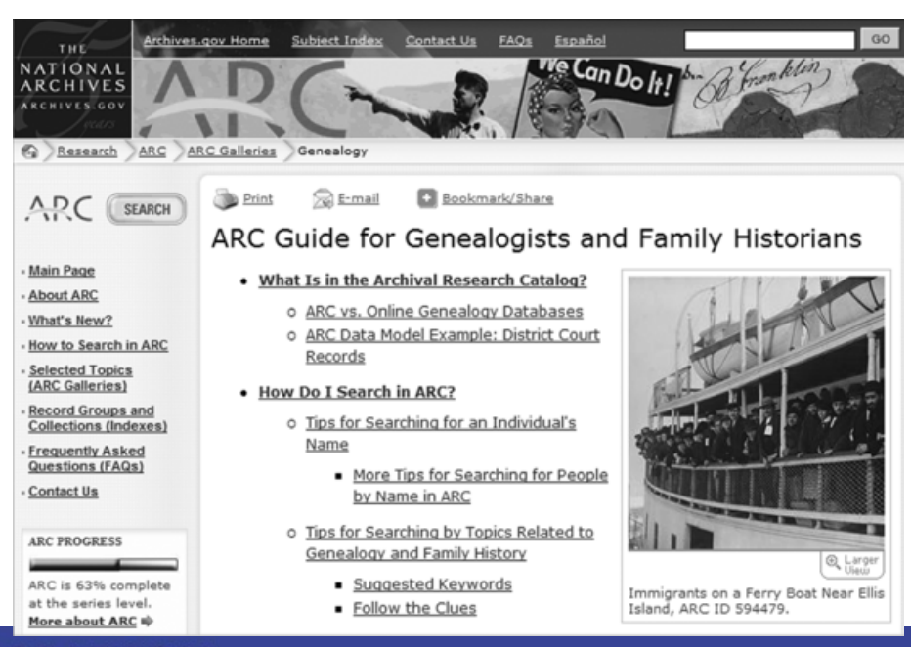
Online Source of Genealogical Information

Slide 31
Text Messaging

Slide 32
Transforming Lives in Developing Countries
M-PESA in Kenya
– Save money
– Pay bills
– Transfer funds
Communicate information about crop prices
Protect against counterfeit medicine

Slide 33
Twitter
Web-based social networking service
More than 200 million users
Blogging tool
Business promotion
Role in Arab Spring uprisings debated
– (+) Social networks lead to politicization
– (-) Ties in social networks too weak for high-risk activism

Slide 34
END OF LECTURE

